Slide 1
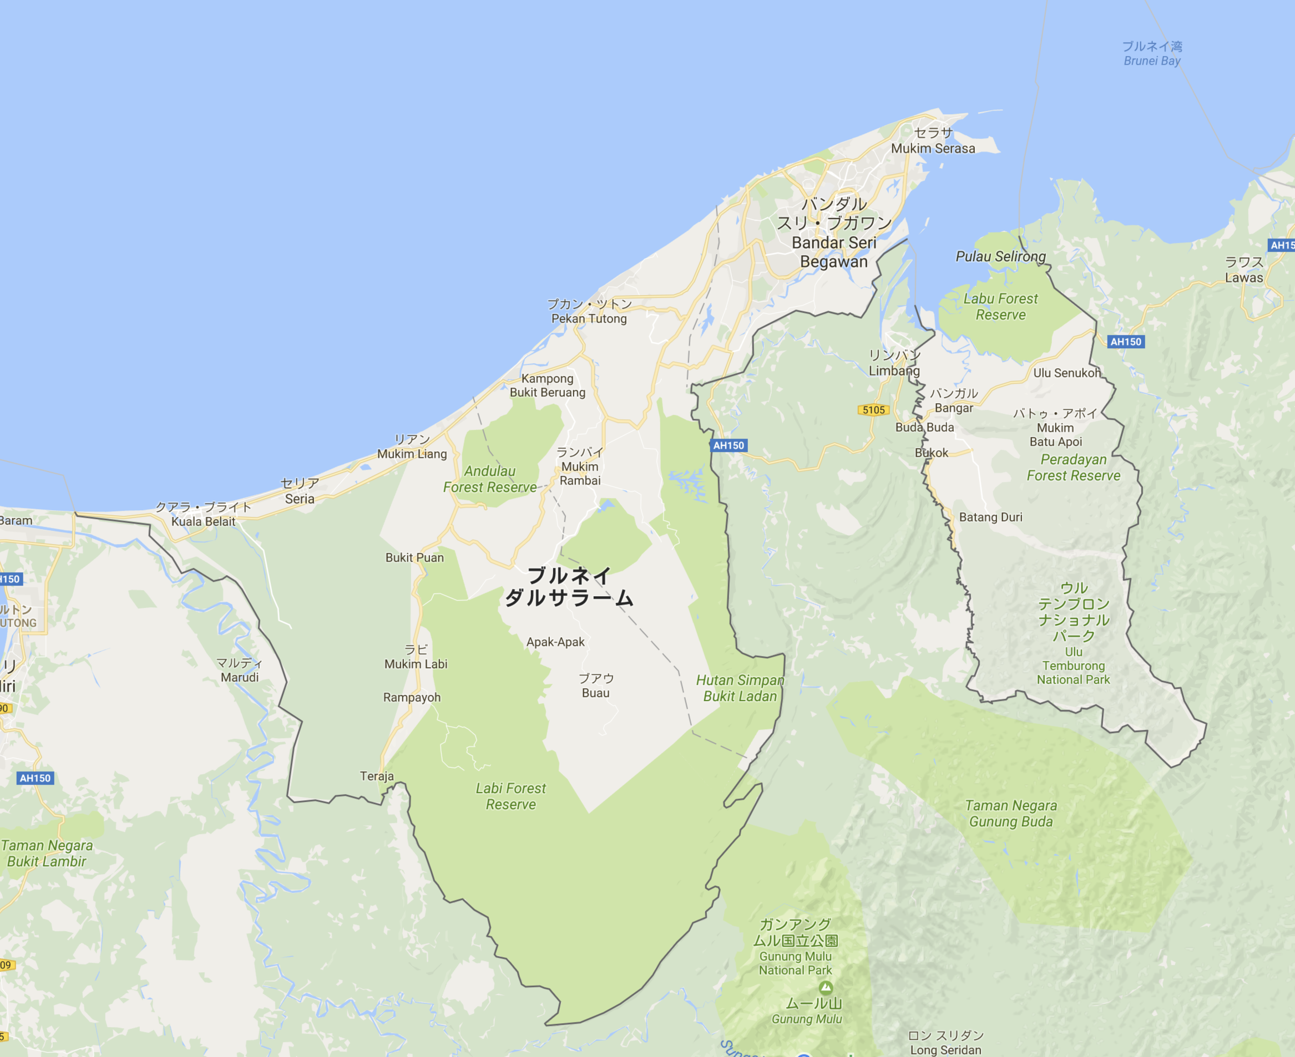
Observation system
installation location plan
Somebody’s House
UBD FIT
We need to install 5 systems
UBD pond
Necessary condition
- AC power supply
- Wi-Fi
Kampong Ayer
Temburong
KBFSC
KBFSC: Kuala Belalong Field Studies Centre

